Slide 1
2022 Spring Assembly Delegates Report
Chris D. P72/A20
March 12, 2022

Slide 2
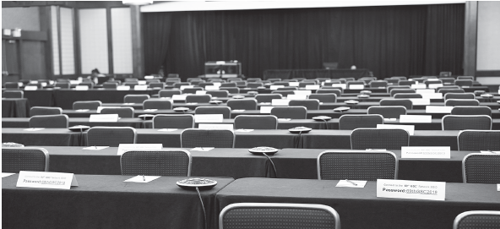
72nd General Service Conference (April 24-30)
Service Structure & Conference Overview-
A.A. Comes of Age 2.0: Unified in Love and Service
Conference Workshop Topic-
The Warranties- Our Promise to the Fellowship and the World
Conference Delegate Presentations-
How Do AA’s go to any length to Recover, Unify & Serve
Going beyond Fear
How to reach Anyone, Anywhere

Slide 3
72nd General Service Conference (April 24-30)
Travel dates are Thursday April 21- Sunday May 1
Starts with Remote communities meeting on Saturday afternoon and then the “Delegates only” meeting on Saturday Night.
Conference Committee Assignment(s)-
Finance
Trustee Chair is Kevin Prior (Class A General Service Board Treasurer)
Archives
Trustee Chair is Al Mooney (Class A Trustee)
Michelle M. (GSO Archivist)

Slide 4
72nd General Service Conference (April 24-30)
Service Highlights (Included in report)
Submitted in writing
Conference Dashboard
To Do lists
Delegate data
Travel arrangements
Billing reimbursements
Final reports (500 English / 50 Spanish)

Slide 5
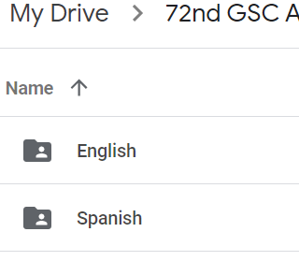
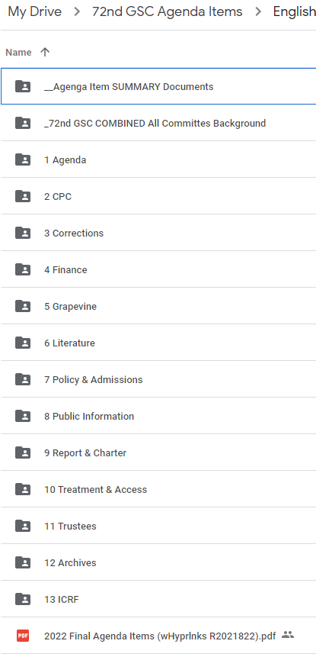
Final Agenda Items & Background Material
Thanks to Erik & Chris for their efforts
Background Material links sent out 2/18/22
Request link from DCM
English & Spanish folders
(15) additional sub-folders

Slide 6
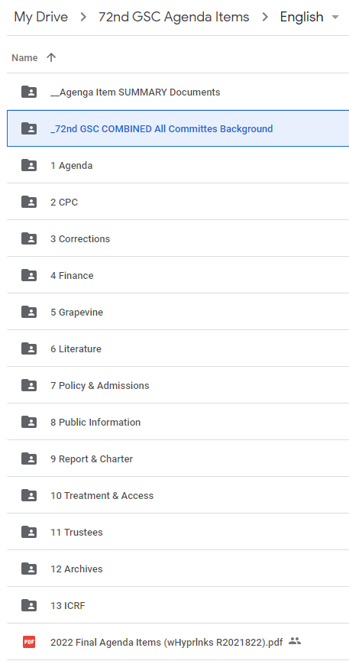
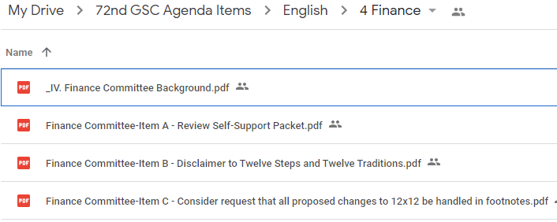
Final Agenda Items & Background Material
(15) Subfolders
Individual Committees
Combined folder
*Hyperlinked Agenda item list
*Summaries

Slide 7
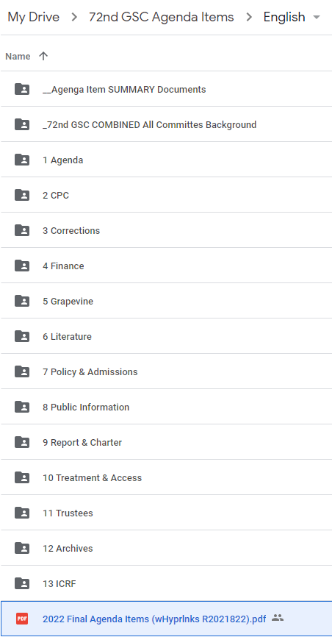
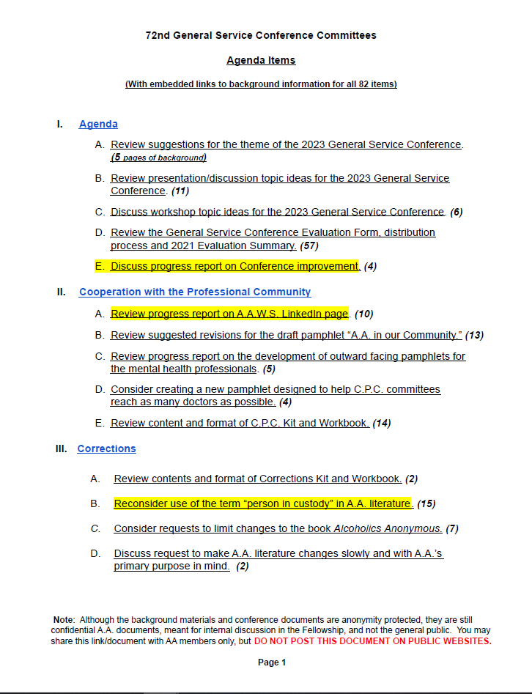
Final Agenda Items & Background Material
Hyperlinked Agenda item list
Highlighted items
Pages of background

Slide 8
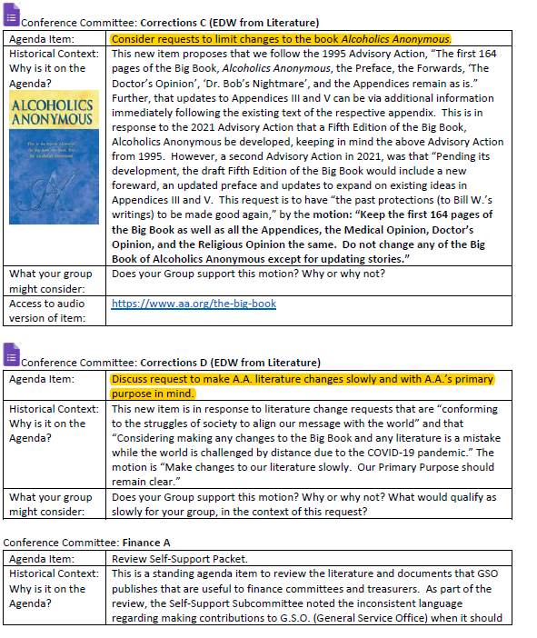
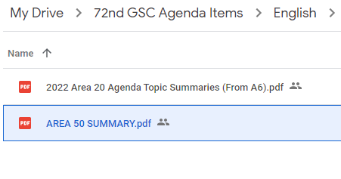
Final Agenda Items & Background Material
SUMMARY documents

Slide 9
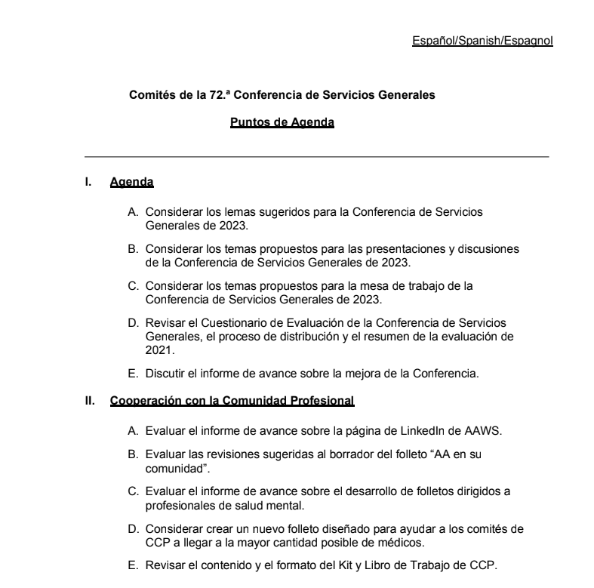
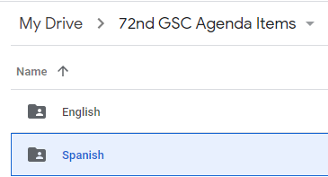
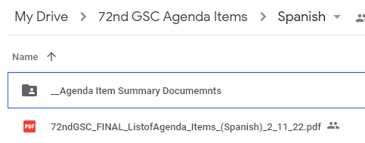
Final Agenda Items & Background Material
Spanish background also available

Slide 10
Activities Since January
East Central Regional Trustee Virtual Breakfast
Regional Delegates
Attended the Conference of Delegates Past & Present (CDPP)
Mock Conference
Finance Committee Calls – (5) calls to date.
Finance Committee members
GSB Treasurer
Archives Committee Calls – (4) calls to date.
Al Moony – Class A & GSO Archivist (Michelle M.)
Attended D22 GSR meeting to discuss the background material
Available to attend other districts or groups
74
34
74
Wisconsin
Eau Claire
Green Bay
Appleton
Manitowoc
34
32
La Crosse
75
Michigan
Madison
Milwaukee
Grand
Rapids
19
Chicago
Lansing
33
Rockford
Kalamazoo
Detroit
Aurora /
Naperville
Ann Arbor
Moline
20
Joliet
55
Cleveland
22
Fort
Wayne
Tol
AKRON
54
Peoria
Bloomington
Ohio
Springfield
Decatur
Indianapolis
56
Illinois
Bloomingto
53
21
Indiana
Dayton
23
Cincinnati
Carbondale

Slide 11
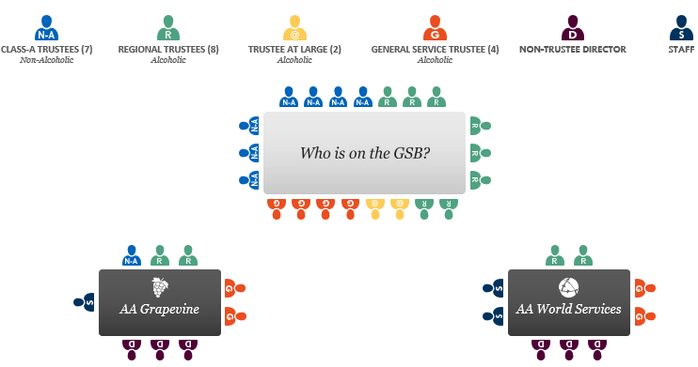
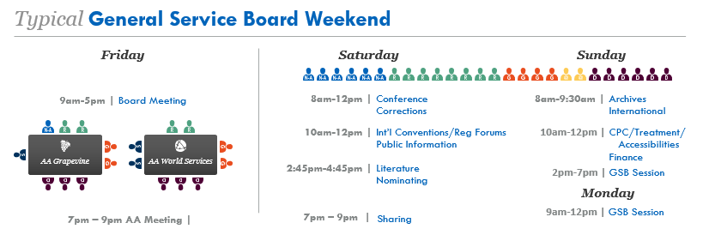
Updates From Quarterly Board Meeting
General Service Board & sub-committees met on Feb. 10.
General Service Board
A.A.W.S
Grapevine
GSO still working from home but meeting weekly to make decision to return to work.
GSO still closed to visitors
Group Services has new “New Group Form”- (Can list as in-person or virtual)
Additional committee info in Trustees report

Slide 12
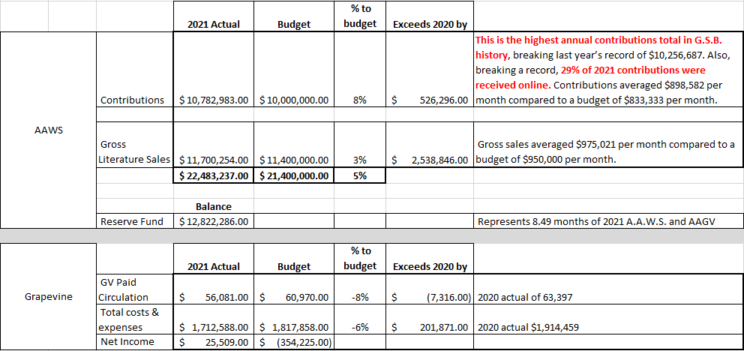
Updates From Quarterly Board Meeting-Financials

Slide 14
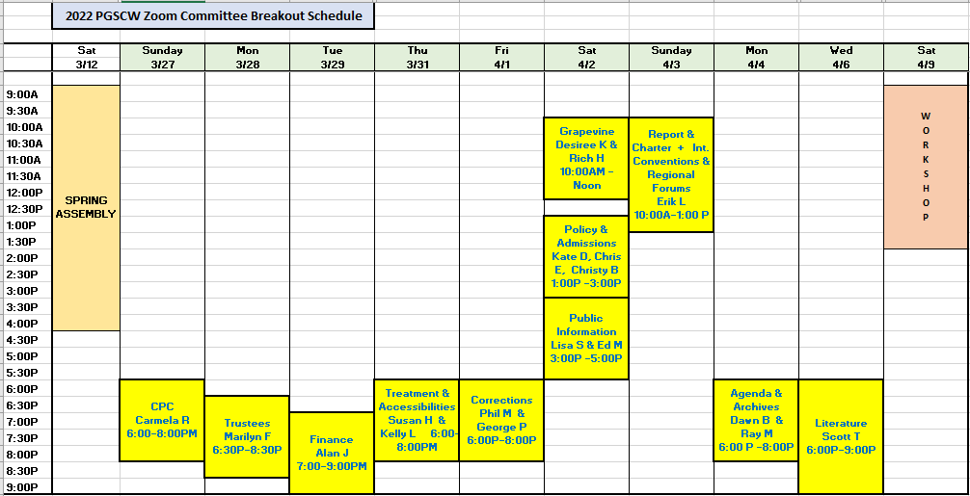
Pre-General Conference Workshop Zoom Schedule
Breakout meeting schedule

Slide 15
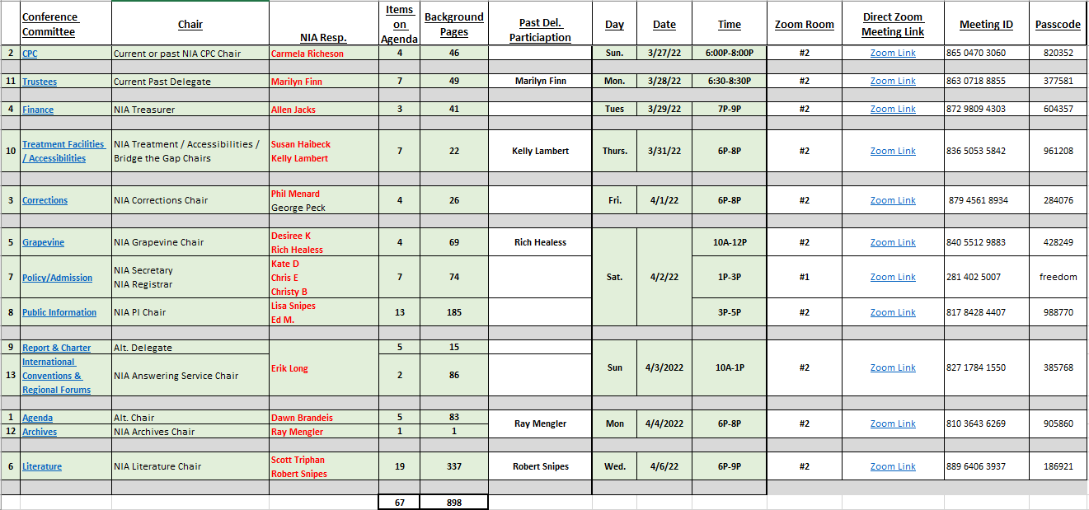
Pre-General Conference Workshop Zoom Links

Slide 16
QUESTIONS – OPEN SHARING

Slide 17
End
No Resource Pooling slide

